Slide 1

Introduction to Computer Science: Programming Methodology
Tutorial 13
Linked list
Florensia Widjaja
(122040013)

Slide 2
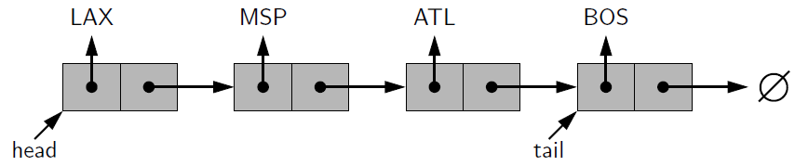
Singly Linked List
Element: the value of a node.
Pointer: pointing to the next node(by its address).
Linked list stores elements in a determined sequence.
node
Refer to SLList.py for the definition of this class.
element
pointer
address
Advantage: save storing space.

Slide 3
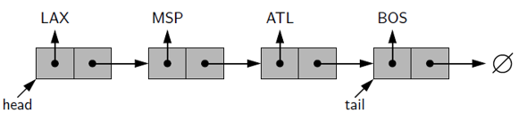
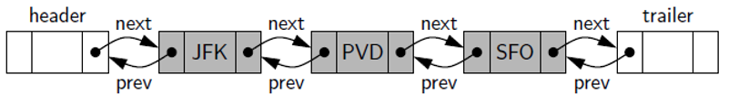
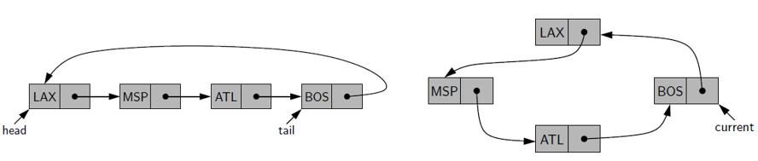
Three Types of Linked List
Singly linked list:
Doubly linked list:
Refer to DLList.py for the definition of this class.
Circularly linked list:
Refer to CLList.py for the definition of this class.

Slide 4
Q1: Concatenate Two Linked Lists
Write a function to concatenate two singly linked lists L and M, given only references to the first node of each list, into a single linked list L’ that contains all the nodes of L followed by all the nodes of M. (Comment: This function should be in the singly linked list class definition as a method.)

Slide 5
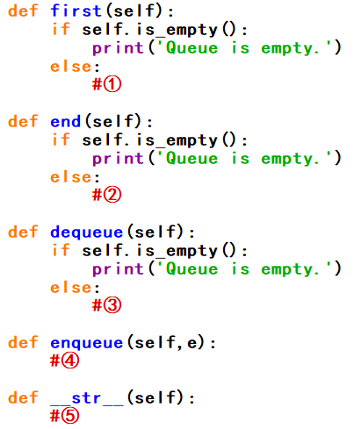
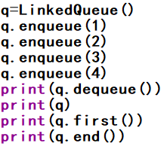
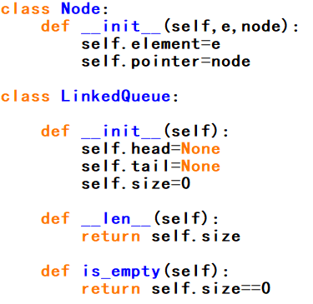

Q2: LinkedQueue
Implement a queue class using linked list. You may fill the blanks ①②③④⑤ on the right. And on the left is the test program.

Slide 6
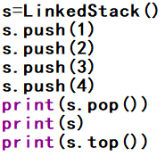
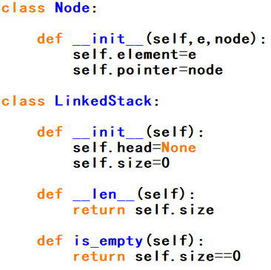
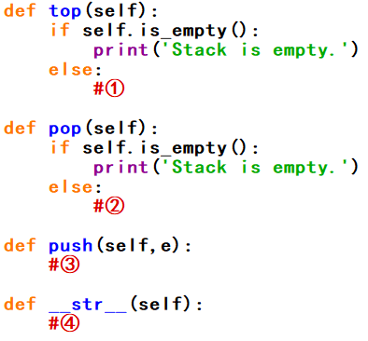

Q3: LinkedStack
Implement a stack class using linked list. You may fill the blanks ①②③④ on the right. And on the left is the test program.

Slide 7
Q4: Insertion sort-I
Insertion sort iterates, consuming one input element each repetition, and growing a sorted output list.
Each iteration, insertion sort removes one element from the input data, finds the location it belongs within the sorted list, and inserts it there. It repeats until no input elements remain.

Slide 8
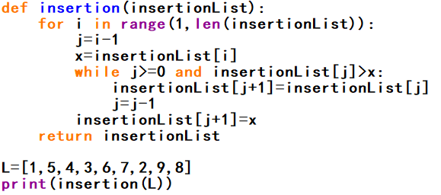
Q4: Insertion sort-I
Below is the insertion sort algorithm implemented by standard list. Please use doubly linked list to implement that in a similar way.

